Slide 1
#03 Arrays and Collections
Notes:
Give an explanation for the concepts array and collections
Relevant theoretical decisions
What is an array, for what and how is it used?
What is an ArrayList, for what and how is it used?
What is the difference between an ArrayList and an array?
Which other collections (Map, List, ...) have you knowledge about?
What do you understand by the concept generic type, how is it used and what is its purpose?
What is a foreach loop and what is its purpose?

Slide 2
.Net Framework and Arrays
Type Safe
Array, List, Dictionary, Sorted Dictionary, Queue and Stack
Interfaces IEnumerable, ICollection and IComparable
Array is a Object that contains Objects
Notes:
most of these collection classes are now type-safe, making for a greatly enhanced programming experience. These classes include the Array, List, Dictionary, Sorted Dictionary, Queue, and Stack.
The .NET Framework provides a number of interfaces, such as IEnumerable and ICollection, whose implementation provides you with standard ways to interact with array, collection and data to compare and control.

Slide 3
Array
Indexed Collection of Objects, all of the same type
Basic declaration and initialization
type[] array-name;
int[] myIntArray;
myIntArray = new int[5];
int[] myIntArray = new int[5] { 2, 4, 6, 8, 10 }
Multidimensional Arrays like C++, Rectangular and Jagged
Notes:
An array is an indexed collection of objects, all of the same type. C# arrays are somewhat different from arrays in C++ because they are objects. This provides them with useful methods and properties.
Technically, you are declaring a variable (myIntArray) that will hold a reference to an array of integers. As always, we’ll use the shorthand and refer to myIntArray as the array, knowing that we really mean a variable that olds a reference to an (unnamed) array.
It is possible to initialize the contents of an array at the time it is instantiated by providing a list of values delimited by curly brackets ({}).
Multidimensional Arrays:
int[,] rectangularArray = new int[rows, columns];
int[][] jaggedArray = new int[rows][];

Slide 4

List
ArrayList is the nontype-safe version of list
In C#2.0 and higher the ArrayList is still available for backward compatibility
In our application we used List to contain card objects
Notes:
In previous versions of C#, the collection objects were not type-safe (you could, for example, mix strings and integers in a Dictionary). The nontype-safe versions of List (ArrayList), Dictionary, Queue, and Stack are still available for backward compatibility

Slide 5
List
Can change in size
List has a number of useful methods which we used in out application
Count() to count the number of card left in the deck
Clear() to empty the deck
Add() to add card to the deck
Notes:
The classic problem with the Array type is its fixed size. If you don’t know in advance how many objects an array will hold, you run the risk of declaring either too small an array (and running out of room), or too large an array (and wasting memory).
Lists provide a number of useful methods and properties for their manipulation.

Slide 6
Collections
Dictionary
Sorted Dictionary
A sorted version of the Dictionary, everything added is sorted
Queue
Stack
Each collection has useful methods to managed the content
Notes:
Dictionary: A dictionary is a collection that associates a key to a value. A language dictionary, such as Webster’s, associates a word (the key) with its definition (the value).
Sorted Dictionary: .Net Framework includes Sorted dictionary class, any data add to a collection of this type is sorted, making it unnecessary to sorted later on.
Queue: A queue represents a first-in, first-out (FIFO) collection. A queue is a good collection to use when you are managing a limited resource.
Stack: A stack is a last-in, first-out (LIFO) collection, like a stack of dishes at a buffet table or a stack of coins on your desk. An item added on top is the first item you take off the stack.
Methods: CopyTo( ), ToArray( ) , Peek( ), Pop( ), Push( ), Clear(), Add(), Count()

Slide 7
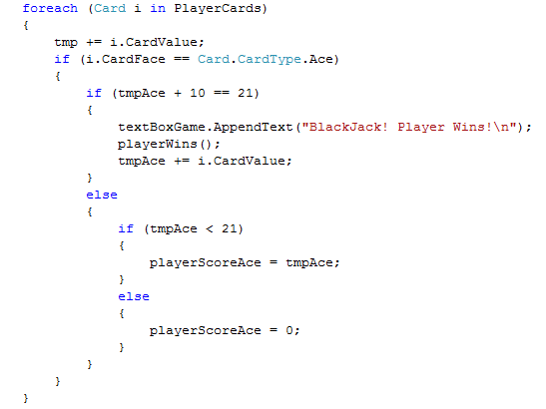
Foreach
Iterates through the array or collection examining each of the elements
Example from our application

Slide 8
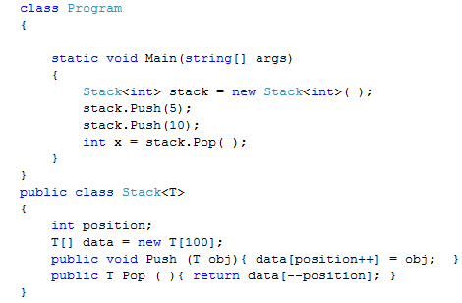
Generic types
Generic Parameter is a type placeholder
Notes:
A generic type declares generic parameters—placeholder types to be filled in by the consumer of the generic type, which supplies the generic arguments.
Here is a generic type Stack<T>, designed to stack instances of type T.
Stack<T> declares a single generic parameter T:
Generics exist to write code that is reusable across different types. Suppose we need a stack of integers, but we don't have generic types. We would have two options. The first and most primitive solution is to copy code from an existing stack implementation, changing the name of the type and the element type to match our specific element type.

Slide 9
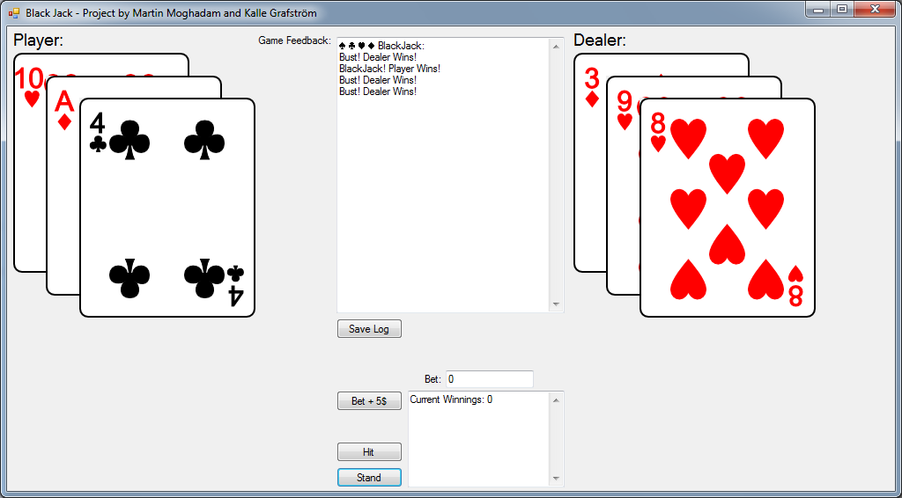
Our program
Black Jack Game
Log
Save Log
Beting
Hit
Stand

Slide 10
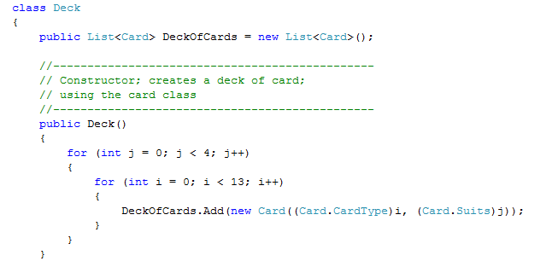
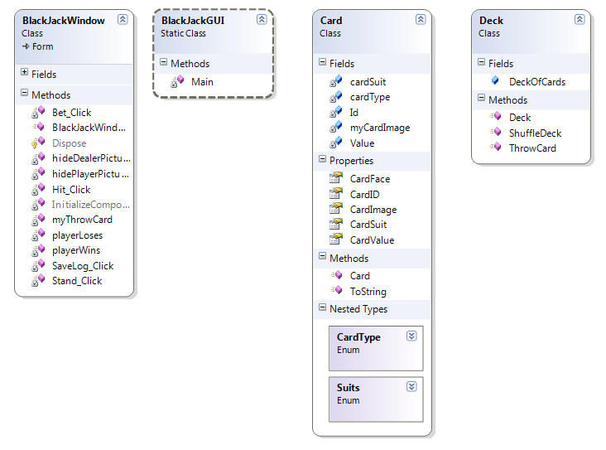
Our program
List and foreach in our application
Notes:
Our application uses list to contain the cards and the foreach statement to manage the cards
Our application contains a simple card class, and a deck class.
A deck of cards is a list that contains objects of the type card.

Slide 11
Questions?

